Slide 1

Inside Sales Mastery Series
Salesforce Reporting and Dashboard
Session# 2
Hosted by: Feedback & Analytics Team (Marketing Operations)
7 November 2024

Slide 2
Table of Contents
Introduction
Reports Creation
Custom Reports
Resources
Reporting Needs

Slide 3
Welcome to Inside Sales Mastery Series
About this Series
  This training series is designed specifically for our inside sales team to enhance your skills in several key areas.
  Gain expertise in essential tools and techniques.
  Learn best practices to streamline your workflow.
  Ensure everyone is on the same page with the latest industry standards and practices.
Ask a question – Pre-submit your questions here or ask during the office hours
Learn how to leverage IQVIA’s marketing systems and processes most effectively
Action: Sign up here, if you need to be added to the outlook invite
Reminder: Save your questions for the end or enter in the chat. We will address as many as we can!

Slide 4
Introduction
Reports are an easy way to retrieve, view, and share a detailed analysis of data
Salesforce Reports can be filtered, grouped and summarized
Salesforce Reports can be displayed graphically through charts
Salesforce Reports can be organized in folders
Salesforce Report Folders determine the level of user access – View, Edit or Manage
Salesforce Report Folders can be public, hidden or shared

Slide 5
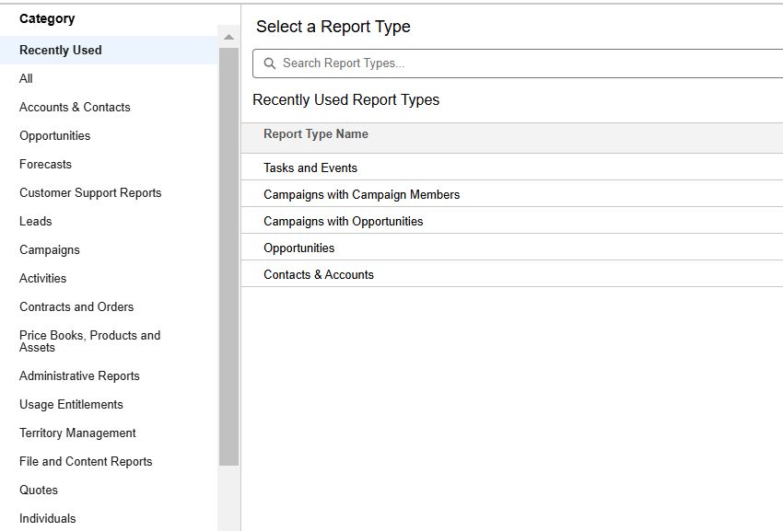
Reports Creation
Log in to your Salesforce account and go to the Reports tab
Click on New Report and select the type of data you're looking to report on, or you can type in keyword to find the report you're looking for

Slide 6
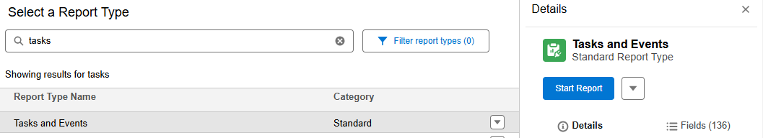
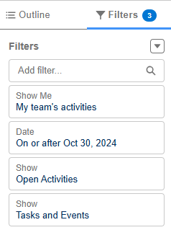
Select the Report Type and click Start Report
Add filters to narrow down the data, click the Add button under the filter and choose the fields to filter by
To Preview the data based on the filters click on Update Preview Automatically

Slide 7
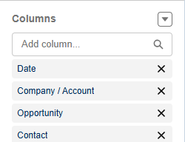

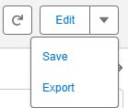
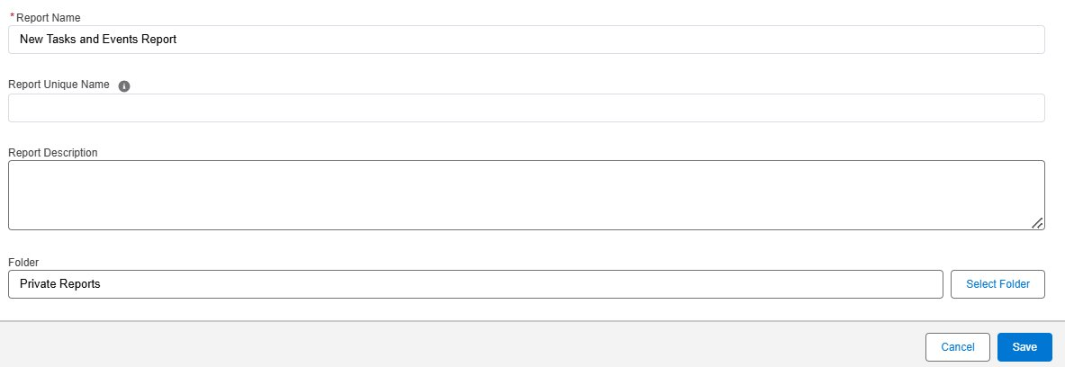
Go to Outline and click the Add button under the Columns section and select the fields to include in the report
Click on Run to verify the report results
Post QA, click on Save and name the report and choose the appropriate folder and Save it

Slide 8
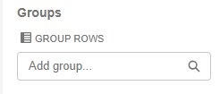

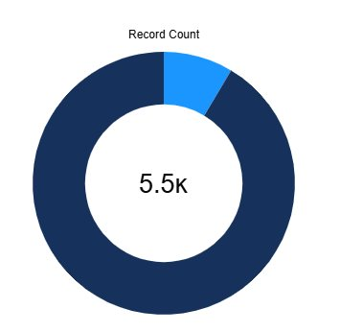
Custom Reports
Grouping and Graphic Representation
Data can be grouped by selecting the fields in the Groups Rows and Group Columns section for summary​ view
Data view can be modified by using the switches at the bottom of the report
​Click on Add Chart and Chart Properties for graphic representation of data

Slide 9
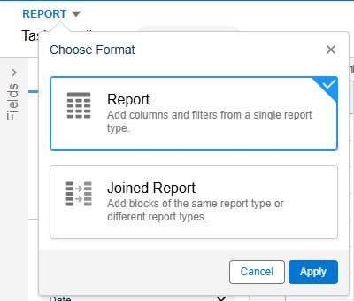

Custom Reports
Joined Reports
Click on Report and select Joined Report and Apply
Click on Add Block and select the Report Type
Click on the Fileds to review additional fields available

Slide 10
Resources
The Trailheads in the Salesforce Help section can help with custom reports and dashboards.
Reports & Dashboards for Lightning Experience
Create Reports and Dashboards for Sales and Marketing Managers

Slide 11
Open Q&A/Discussion

Slide 12
Reporting Needs
Inside Sales Team Dashboard -Understanding Task Management: Due and Overdue Tasks
Navigating Stages Reports: Focus on RFP Received
Tracking Number of Accounts Created by IS Team
Monitoring Contacts Created and Net New Meetings
Opportunity Management
Analyzing RFP Wins by Salesperson
Weekly and Quarterly Task Breakdown Reports
Generating Reports by Accounts and Job Titles
Manager View Dashboard: Tracking Reps’ Completed Tasks and Opportunities Created
Global Inside Sales Dashboard

Slide 13
Thank You!

